Slide 1




Slide 2

To complete Task 1 you must solve a series of puzzles. Correct answers will generate the first part of the combination.

Slide 3
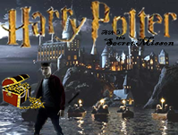


Slide 4
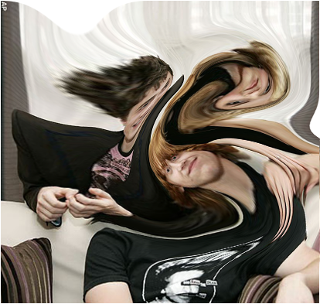
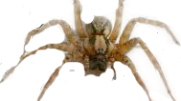


Slide 6

To complete Task 2 you must watch a short animation and answer a number of questions about what you have seen and heard. Correct answers will generate the next part of the combination.

Slide 7

To complete Task 3 players must watch a short movie and then answer questions about it. Correct answers will generate the last part of the combination. The questions must appear at the end of the movie.

